Slide 1

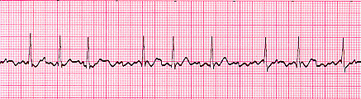
Clinical Title
Date
Atrial Fibrillation:
How Your “Type” Affects Your Treatment
July 10th, 2013
Jaret Tyler, MD
Clinical Cardiac Electrophysiologist
Assistant Professor of Medicine
Ohio State’s Heart and Vascular Center

Slide 2

Disclosures
None

Slide 3
Objectives
What Is Atrial Fibrillation?
  Epidemiology
  Risk Factors
  Classification or “Type”
Mechanisms
  Trigger and Substrate
Treatment
  Medications, Ablations, Devices

Slide 4
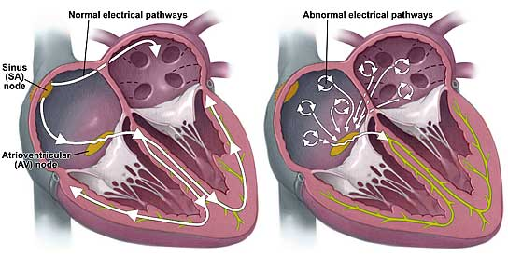
Atrial Fibrillation
Definition
  Common supraventricular arrhythmia characterized by uncoordinated atrial activation with consequent deterioration of atrial mechanical function

Slide 5

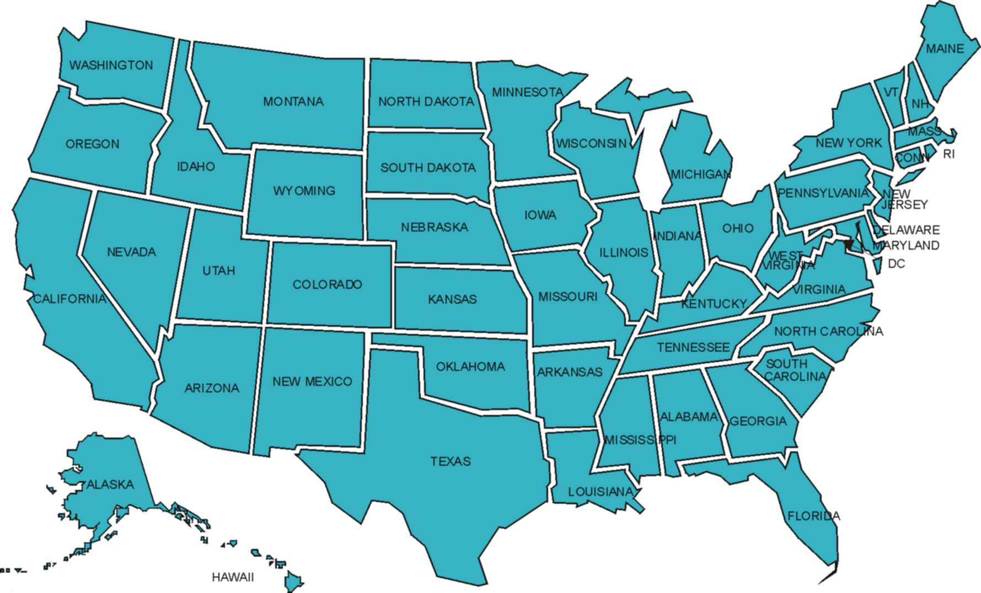
Atrial Fibrillation
Most common arrhythmia in clinical practice

Slide 6
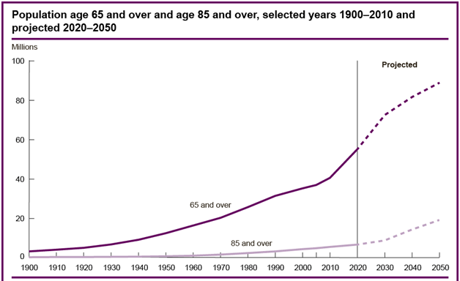
Atrial Fibrillation

Slide 7
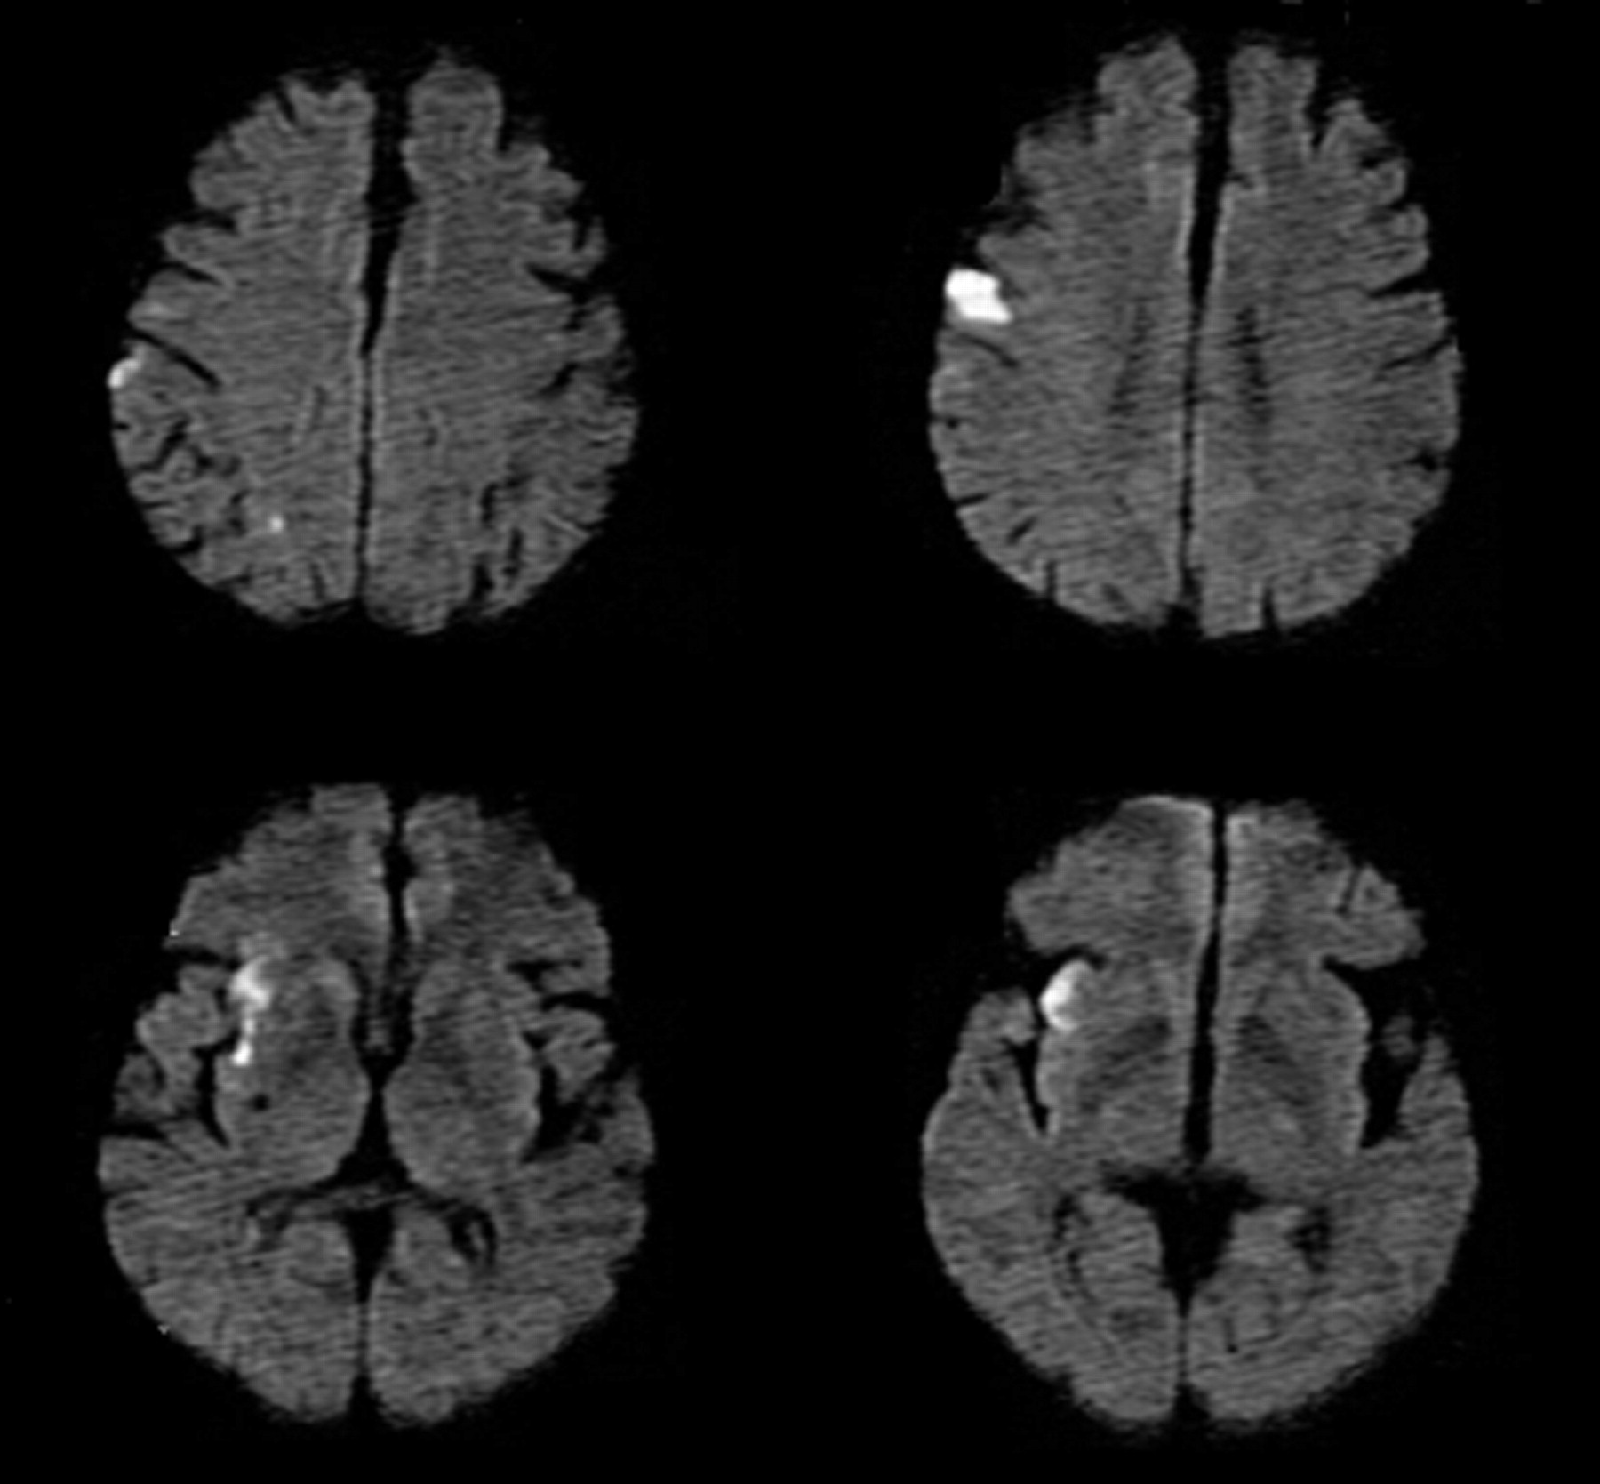

Atrial Fibrillation

Slide 8
Risk Factors for AF
Modifiable
Non-Modifiable
Obesity
Sleep Apnea
Alcohol – “Holiday Heart”
HTN
Medical conditions
Diabetes
Thyroid Disease
Structural Heart Disease
COPD / PTE
Genetic disorders
Age
Sex – Male
Tall stature
Pericarditis/Myocarditis
Surgery
Other Arrhythmias
MI

Slide 9
“Types”
Paroxysmal AF
  Recurrent AF (≥ 2 episodes) that terminates spontaneously within 7 days
    Episodes ≤ 48 hours duration that are terminated with electrical or pharmacologic cardioversion
Persistent AF
  Continuous AF that is sustained beyond 7 days
    Episodes ≥ 48 hours but < 7 days that are terminated with electrical or pharmacologic cardioversion

Slide 10
“Types”
Longstanding Persistent AF
  Continuous AF of > 12 months duration
Permanent AF
  Decision made not to restore or maintain sinus rhythm by any means
  Therapeutic attitude not pathophysiological attribute

Slide 11
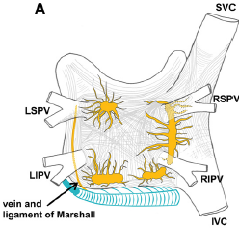
Mechanisms of Atrial Fibrillation

Slide 12
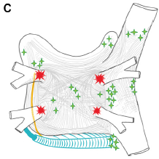
Mechanisms of Atrial Fibrillation

Slide 13
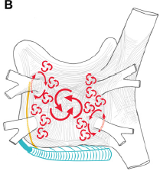
Mechanisms of Atrial Fibrillation

Slide 14
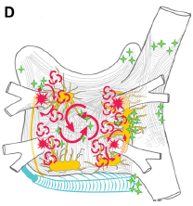
Mechanisms of Atrial Fibrillation

Slide 15
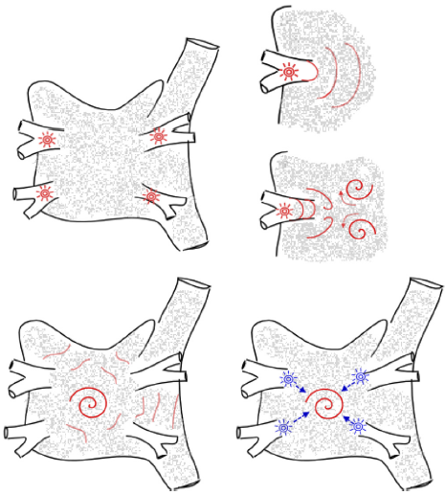
Mechanisms of Atrial fibrillation

Slide 16
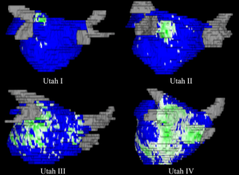
Mechanisms of Atrial Fibrillation

Slide 17
Treatment of Atrial Fibrillation
Acute
  Anticoagulate and Rate Control
    “Type” does not affect choice of anticoagulant or method of rate control
  First Occurrence?

Slide 18
Treatment of Atrial Fibrillation
Goals of Long-Term Treatment
  Anticoagulation to prevent stroke
  Prevention of tachycardia-induced cardiomyopathy
  Improvement in symptoms, functional capacity, and quality of life

Slide 19
Treatment of Atrial Fibrillation
Stroke Risk and Reduction
  AF is an independent risk factor for stroke
  CHADS₂ or CHA₂DS₂-VASc

Slide 20

Treatment of Atrial Fibrillation
C – Congestive Heart Failure
H – Hypertension
A – Age > 75 years
D – Diabetes Mellitus
S₂ – Stroke or TIA history
C – Congestive Heart Failure
H – Hypertension
A₂ – Age > 75 years
D – Diabetes Mellitus
S₂ – Stroke or TIA history
V – Vascular Dz or CAD
A – Age > 65 years
S_{c} – Sex

Slide 21
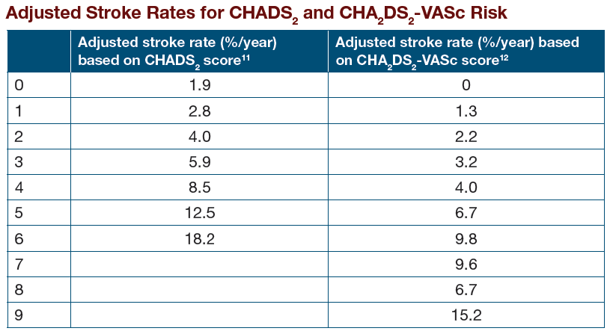
Treatment of Atrial Fibrillation

Slide 22
Treatment of Atrial Fibrillation
No Risk Factor
  ASA 81 – 325 mg daily
1 Point
  ASA 81 – 325 mg daily, or oral coagulant
≥ 2 Points
  Oral anticoagulant

Slide 23
Treatment of Atrial Flutter
No Risk Factor
  ASA 81 – 325 mg daily
1 Point
  ASA 81 – 325 mg daily, or oral coagulant
≥ 2 Points
  Oral anticoagulant

Slide 24
Treatment of Atrial Fibrillation
Asymptomatic
  Rate control
Symptomatic
  Rate control
  Rhythm control

Slide 25
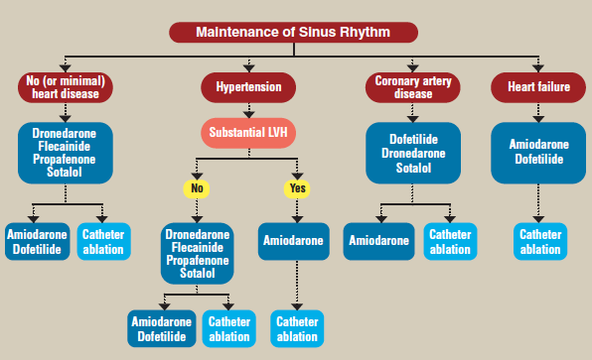
Anti-Arrhythmic Drugs

Slide 26
Why Ablate AF?
Decrease stroke risk
Decrease heart failure risk
Improve survival
Get off anticoagulation
Improvement in quality of life

Slide 27
Treatment of Atrial Fibrillation
Catheter Ablation
  Recommended for patients with symptomatic paroxysmal AF (PAF) who are refractory or intolerant to at least one anti-arrhythmic medication
Most success with PAF but can be used to treat AF of any duration
  Success rate ~ 40-80%
Recurrence of AF after index AF ablation procedures leads to repeat ablation in up to 50% of patients

Slide 28
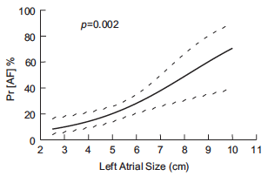
Treatment of Atrial Fibrillation
Lower Success/ Higher Complications
  Duration of time a patient has been in continuous atrial fibrillation (e.g., remodeling/fibrosis)
  Concomitant heart disease
  Obesity/Sleep apnea
  Left atrial size

Slide 29
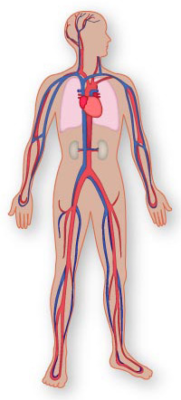

Slide 30
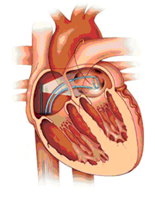

Slide 31
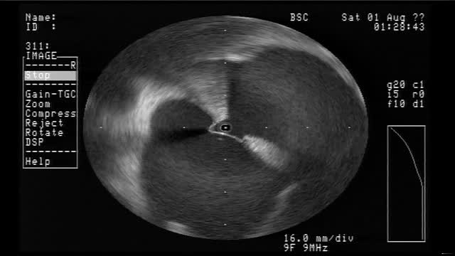

Slide 32
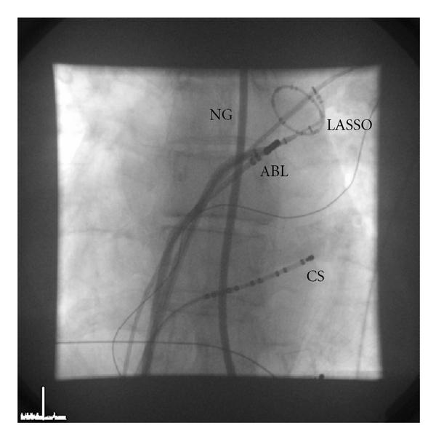

Slide 33
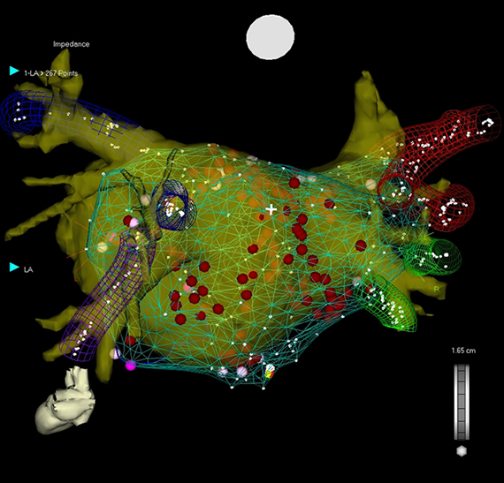
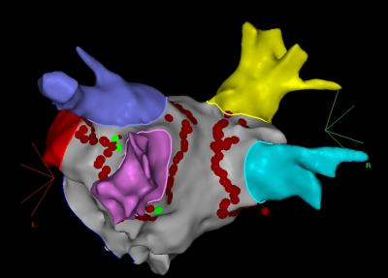
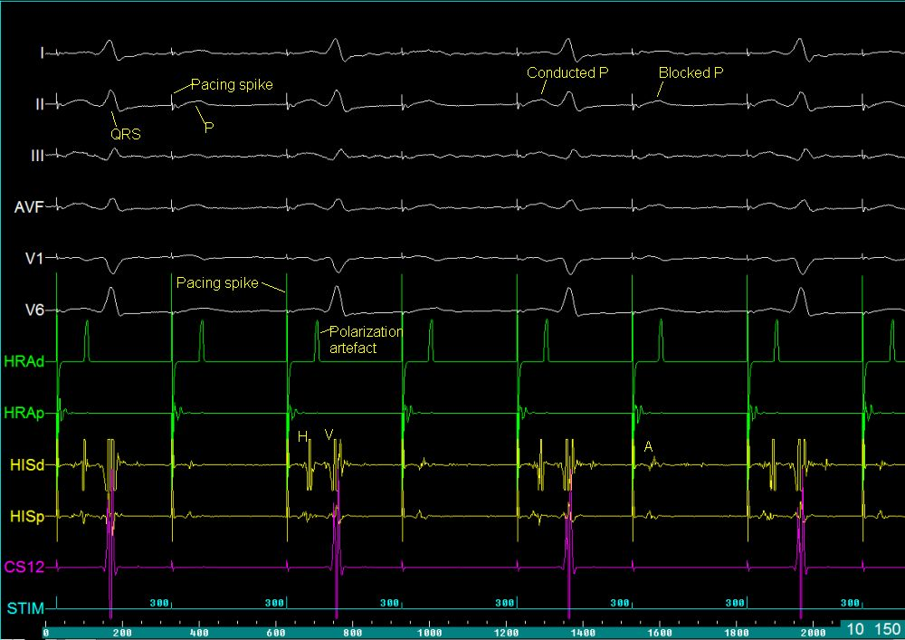
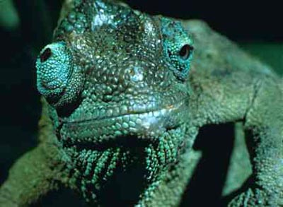
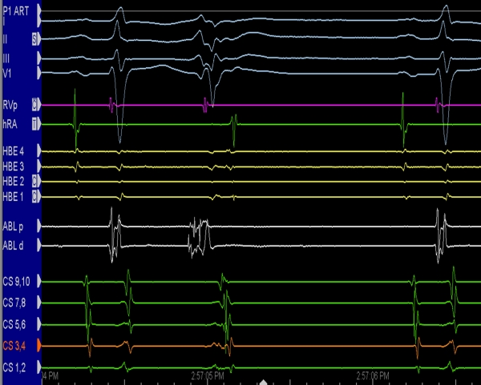
Physicians Point of View

Slide 34
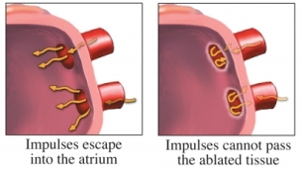
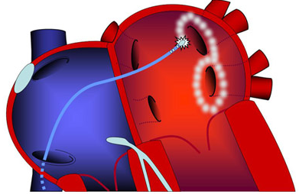
Ablation Approaches
Targeting Pulmonary Veins
  Standard therapy for PAF

Slide 35
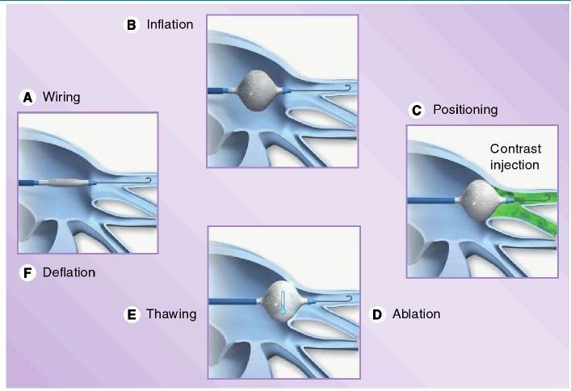
Ablation Approaches

Slide 36
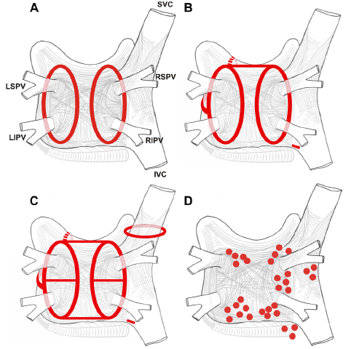
Ablation Approaches

Slide 37
Ablation Approaches
Why not perform linear lesions on everyone?
  Linear lesions are not easy
  Gaps
  Propensity for left atrial flutters
Role of linear lines in persistent AF controversial
Persistent and Long-Standing Persistent AF
  Stepwise approach
    PVI
    CFAE
    Linear lines

Slide 38
Ablation Approaches
PVI is the cornerstone
Focal trigger targeting
Linear Lesions
CTI if flutter
Longstanding persistent
  Linear lesions and CAFEs

Slide 39
Management not Affected by “Type”
Anticoagulation pre and immediately post ablation (2 months)
Pre-operative evaluation with TEE and atrial imaging (CT or MRI)
Event monitor in follow-up

Slide 40

Early Recurrence of AF Post Ablation
Anti-Arrhythmic Drugs Post Ablation
  Irritable, maturing lesions
  immediately post ablation
  Decrease early recurrence
  of atrial arrhythmias
  No effect on prediction or prevention of arrhythmia recurrence at 6 months
  No effect on PAF vs. Non-PAF
  ablation success

Slide 41



Efficacy of catheter ablation
Paroxysmal AF
  Ablation: 66 – 89%
Long-standing Persistent
  Ablation: 47%
  Medications: 9 – 58%

Slide 42
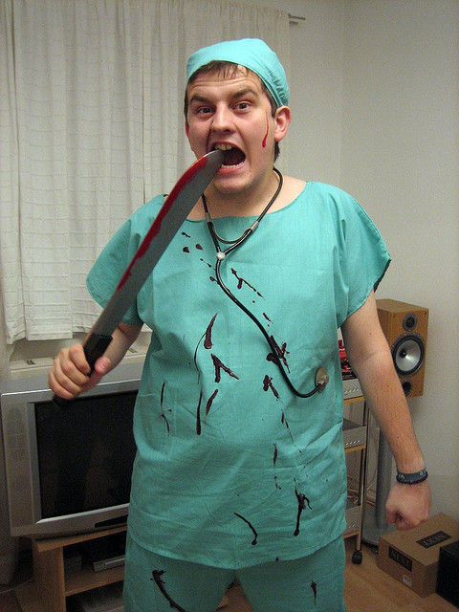

Slide 43
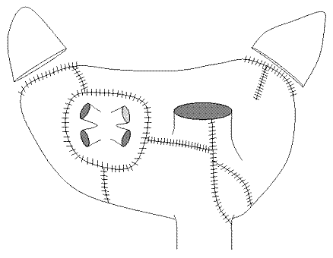
Surgical Ablation of Atrial Fibrillation
Cox/Maze Procedure
  Dr. James Cox
  Interrupt all macro-reentrant circuits
    Multiple wavelet hypothesis
  Cox/Maze III

Slide 44
Surgical Ablation of Atrial Fibrillation
Cox/Maze III
  73 – 80% success
    Off anti-arrhythmic medications
  Higher incidence of complications
    10.7 – 13.9%
    8 – 23% needed a pacemaker
  Complex, Difficult, Risks

Slide 45
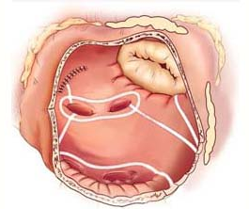
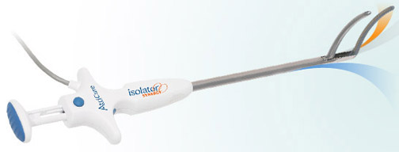
Surgical Ablation of Atrial Fibrillation
Replace “Cut-and-Sew” with linear ablation

Slide 46
Surgical Ablation of Atrial Fibrillation
Cox/Maze IV
  78% sinus Rhythm off anti-arrhythmic meds
  No difference from Cox/Maze III in freedom from AF
  Complications 11%
  Pacemakers 9% post-operatively
  No difference in paroxysmal vs. persistent or longstanding persistent (p=0.378)
  Predictors of recurrence were absence of a box lesion set, increasing left atrial diameter, and early post-operative arrhythmias

Slide 47
Surgical Ablation of Atrial Fibrillation
Summary
  Need more multicenter clinical trials with uniform definitions and follow-up
  Good long-term results
  Consider for ALL patients with symptomatic AF undergoing other cardiac surgery
  Stand-alone surgical ablation is not recommended prior to initiation of anti-arrhythmic drug therapy
  PVI with connection to MV annulus
  Bi-Atrial procedure for those with persistent and longstanding persistent AF
  Complete occlusion of LAA

Slide 48
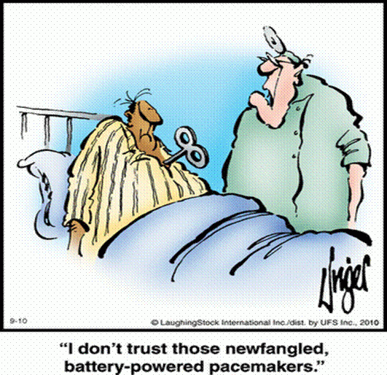
Device Therapy for Atrial Fibrillation

Slide 49
Device Therapy for Atrial Fibrillation
Pacemakers/ICD do not “cure” atrial fibrillation
Patients with atrial fibrillation have sick sinus syndrome by association
Helpful in Tachy-Brady Syndrome
  All “Types” of AF, including Permanent AF
AV nodal ablation

Slide 50
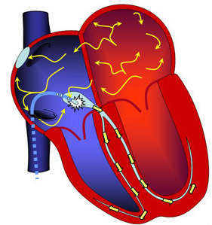
Device Therapy for Atrial Fibrillation
AV Nodal Ablation
  Ablate and Pace
    Rapid heart rates
    despite max Rx
    Often yields remarkable
    symptom relief
  Growing concern for
  chronic RV pacing
  BiV Pacing

Slide 51
Conclusions
Atrial Fibrillation is prevalent and affecting more people every year
Continuous evolution of understanding causes
Continuous evolution in treatment strategies, becoming more tailored to one’s AF “Type”
Toddler stages

Slide 52
Unanswered Questions
What if I failed catheter ablation?
  No head-to-head comparisons
What are the comparative success rates of various ablative techniques in differing patient populations, particularly persistent and longstanding persistent AF?
Is there an acceptable rationale for ablation applied as first line therapy for AF?
What are the very long-term outcomes (> 5 years) of catheter and surgical AF ablation?
What “new” technology is on the horizon and how will this affect outcomes?

Slide 53

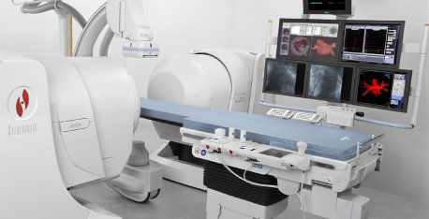
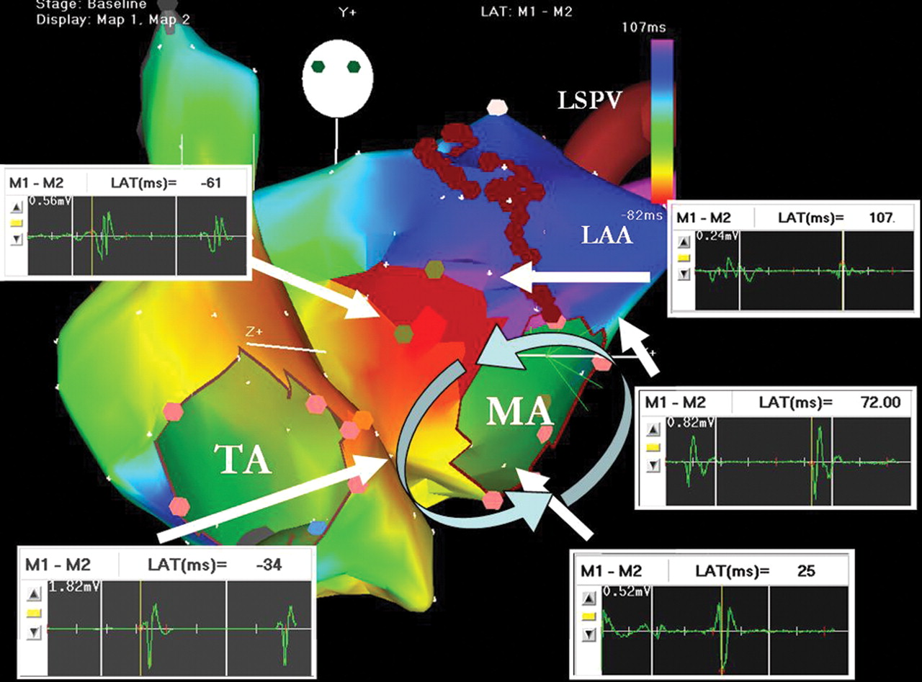
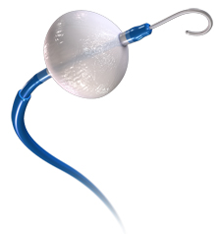
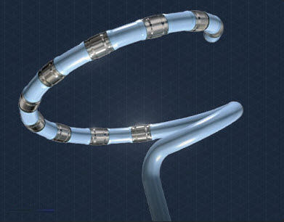
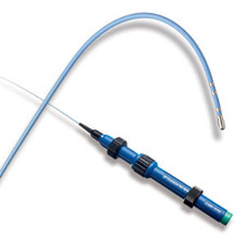
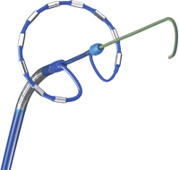
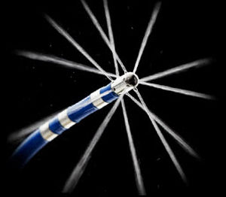
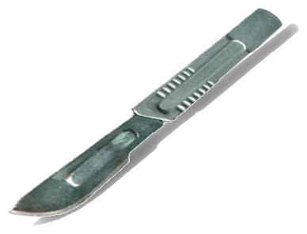

Evolution of AF Treatment

Slide 54


