Slide 1

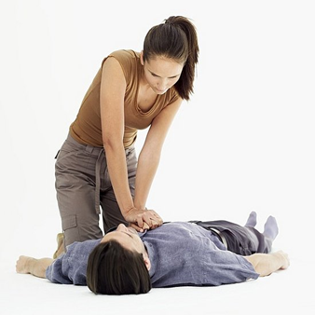
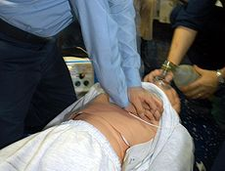
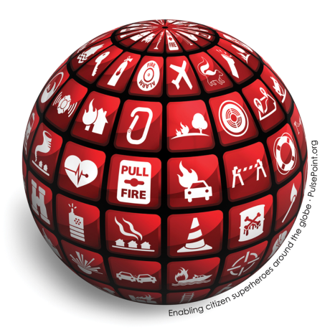
Dr. David P. Keseg MD FACEP
Medical Director Columbus Division of Fire
Associate Professor of Emergency Medicine at The Ohio State University

Slide 2
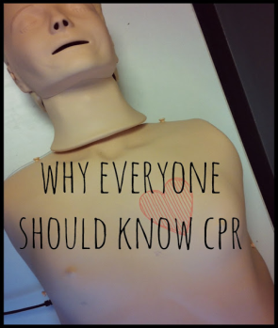
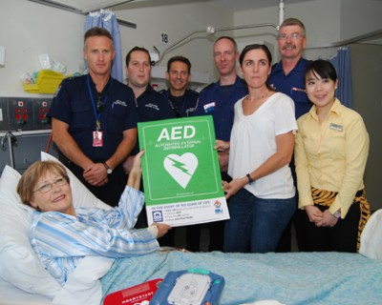
Current Statistics
350,000 cardiac arrests in USA each year
1 in every 90 seconds
  36% In-hospital
    18% of which survive to discharge
  64% out of Hospital
    2-9% of which survive to discharge

Slide 3
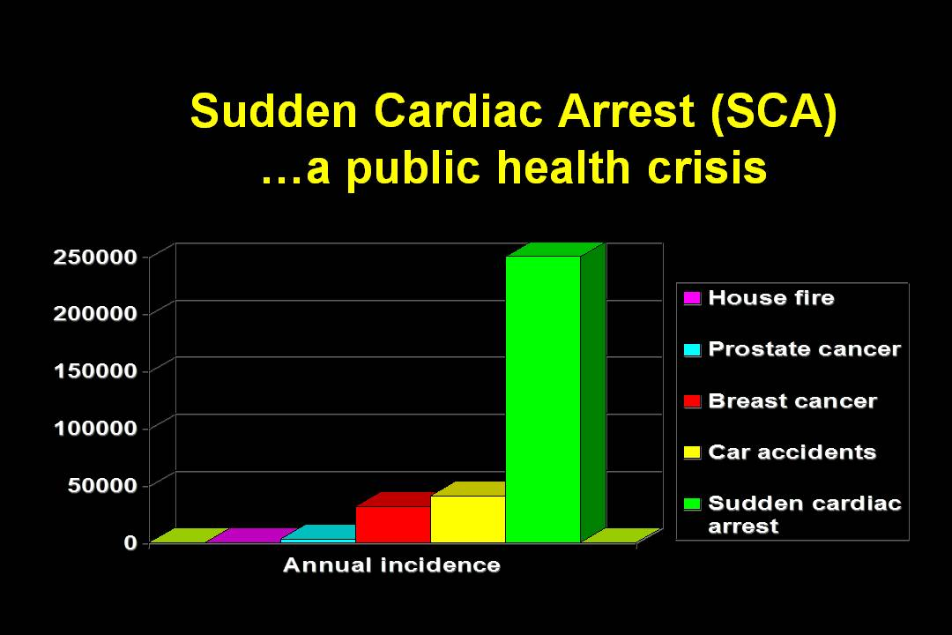

Slide 4
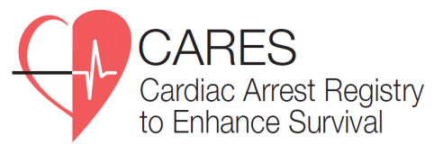

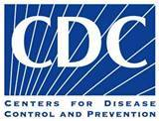
CARES
FACT SHEET
Uses a secure Web database with restricted access for authorized users.
Has software that collects and links data sources to create a single de-identified record for each OHCA event.
Uses a simple, HIPAA-compliant methodology to protect confidentiality.
Accepts a variety of input methods, such as uploaded data files or online data entry.
Collects 9-1-1 computer-aided dispatch data for EMS response times.
Allows longitudinal, internal benchmarking of key performance indicators.
Provides multiple reporting features, including charts, graphs, and maps.
CARES helps local EMS administrators and community leaders determine:
Who is affected in my community?
When and where are cardiac events happening?
What parts of the system are working well?
What parts of the system could work better?
How can we improve emergency cardiac treatment?
More information is available at https://mycares.net

Slide 5
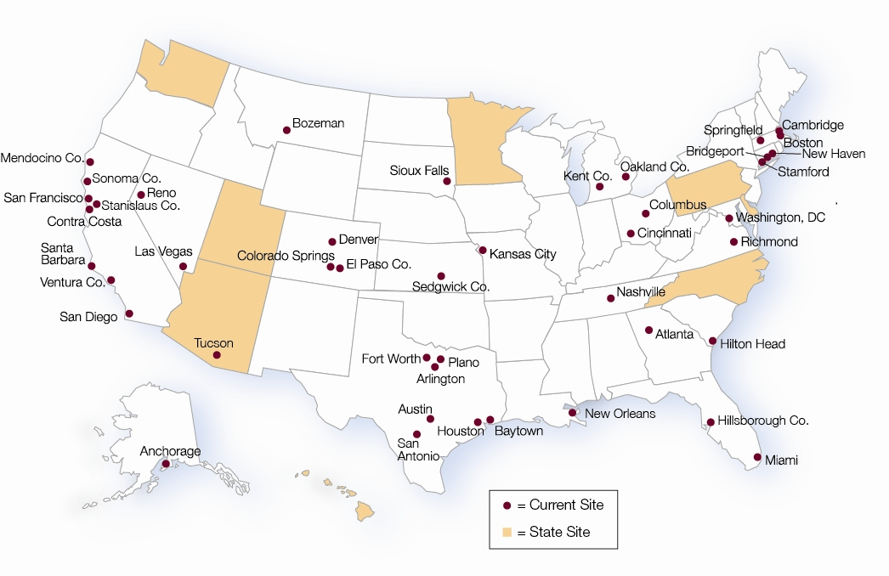
CARES
FACT SHEET
40 communities in 26 states
8 statewide registries
Covers a catchment area of over 80 million
More than 400 EMS agencies
More than 900 hospitals

Slide 6
CARES DEMOGRAPHIC AND SURVIVAL CHARACTERISTICS OF OHCA 10/1/05-12/31/12

Slide 7
CARES DEMOGRAPHIC AND SURVIVAL CHARACTERISTICS OF OHCA 10/1/05-12/31/12

Slide 8
CARES DEMOGRAPHIC AND SURVIVAL CHARACTERISTICS OF OHCA 10/1/05-12/31/12

Slide 9
CARES DEMOGRAPHIC AND SURVIVAL CHARACTERISTICS OF OHCA 10/1/05-12/31/12

Slide 10
CARES DEMOGRAPHIC AND SURVIVAL CHARACTERISTICS OF OHCA 10/1/05-12/31/12

Slide 14
CENSUS TRACTS WITH HIGH RISK FOR OHCA 2005-2009

Slide 16
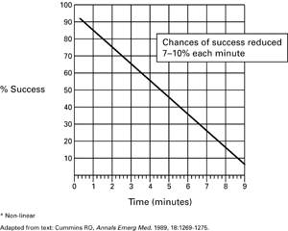
Early CPR Critical in SCA

Slide 17
90 Seconds of CPR Before Defibrillation
Cobb, L.A., et al. Influence of CPR prior to defibrillation in patients with out-of-hospital VF. JAMA 1999; 281(13):1182-8.

Slide 18
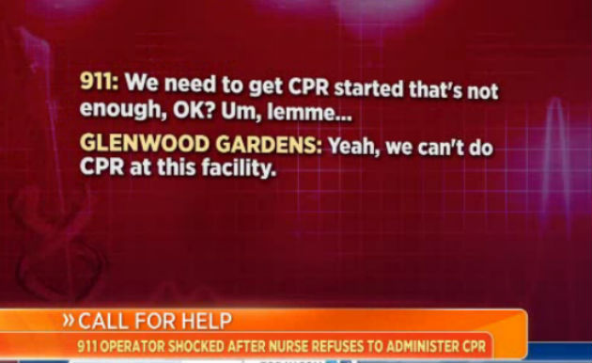
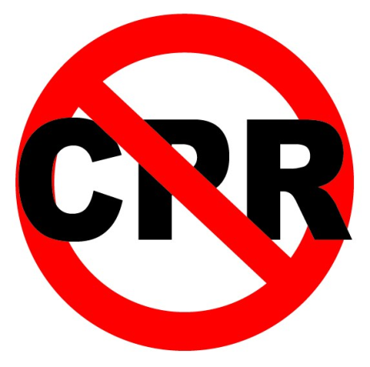
Bystanders in the US only do CPR in 15 to 30 percent of out-of-hospital cardiac arrests
The odds of survival drop significantly after four to six minutes without CPR in witnessed arrests (and the victim’s heart rhythm is ventricular fibrillation
EMS providers generally can’t get to a scene for six to eight minutes

Slide 19
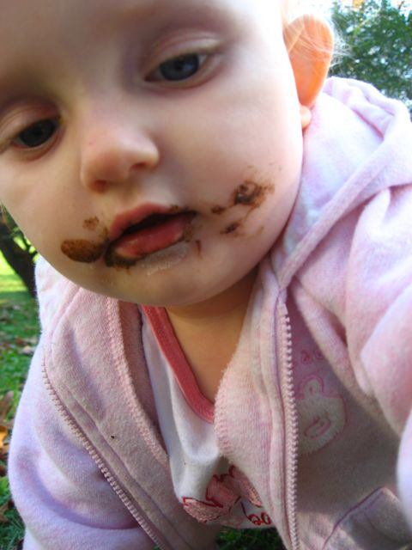
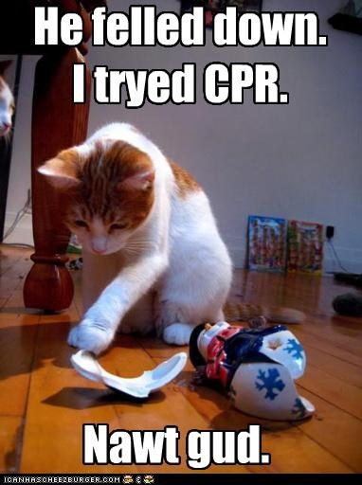

Why People Don’t Do CPR
Mouth to Mouth- YUCK!
Don't want to take a class
CPR too complex
Hard to remember all those facts
Don’t want to hurt them!
Might not be doing it right???
I might get sued!!!

Slide 20

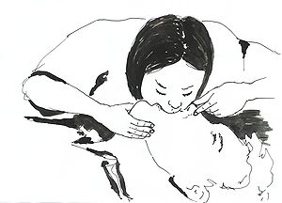
Mouth-To-Mouth Ventilation's Role In CPR Questioned
Sep. 20, 1997 — A blue-ribbon panel of experts assembled by the American Heart Association has called into question the role of mouth-to-mouth ventilation as an integral part of cardiopulmonary resuscitation (CPR).
Mouth-to-mouth ventilation can interfere with the rescuer's efforts to perform chest compressions and cause significant adverse effects.
It makes CPR more difficult to teach, learn and perform, and dissuades bystanders from initiating therapy.

Slide 21
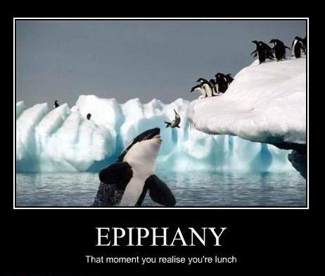

Slide 22

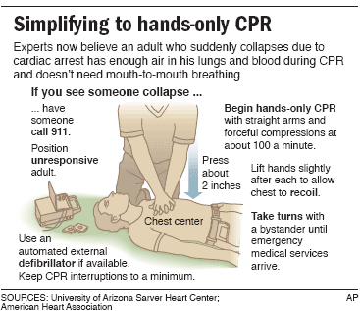

Slide 24
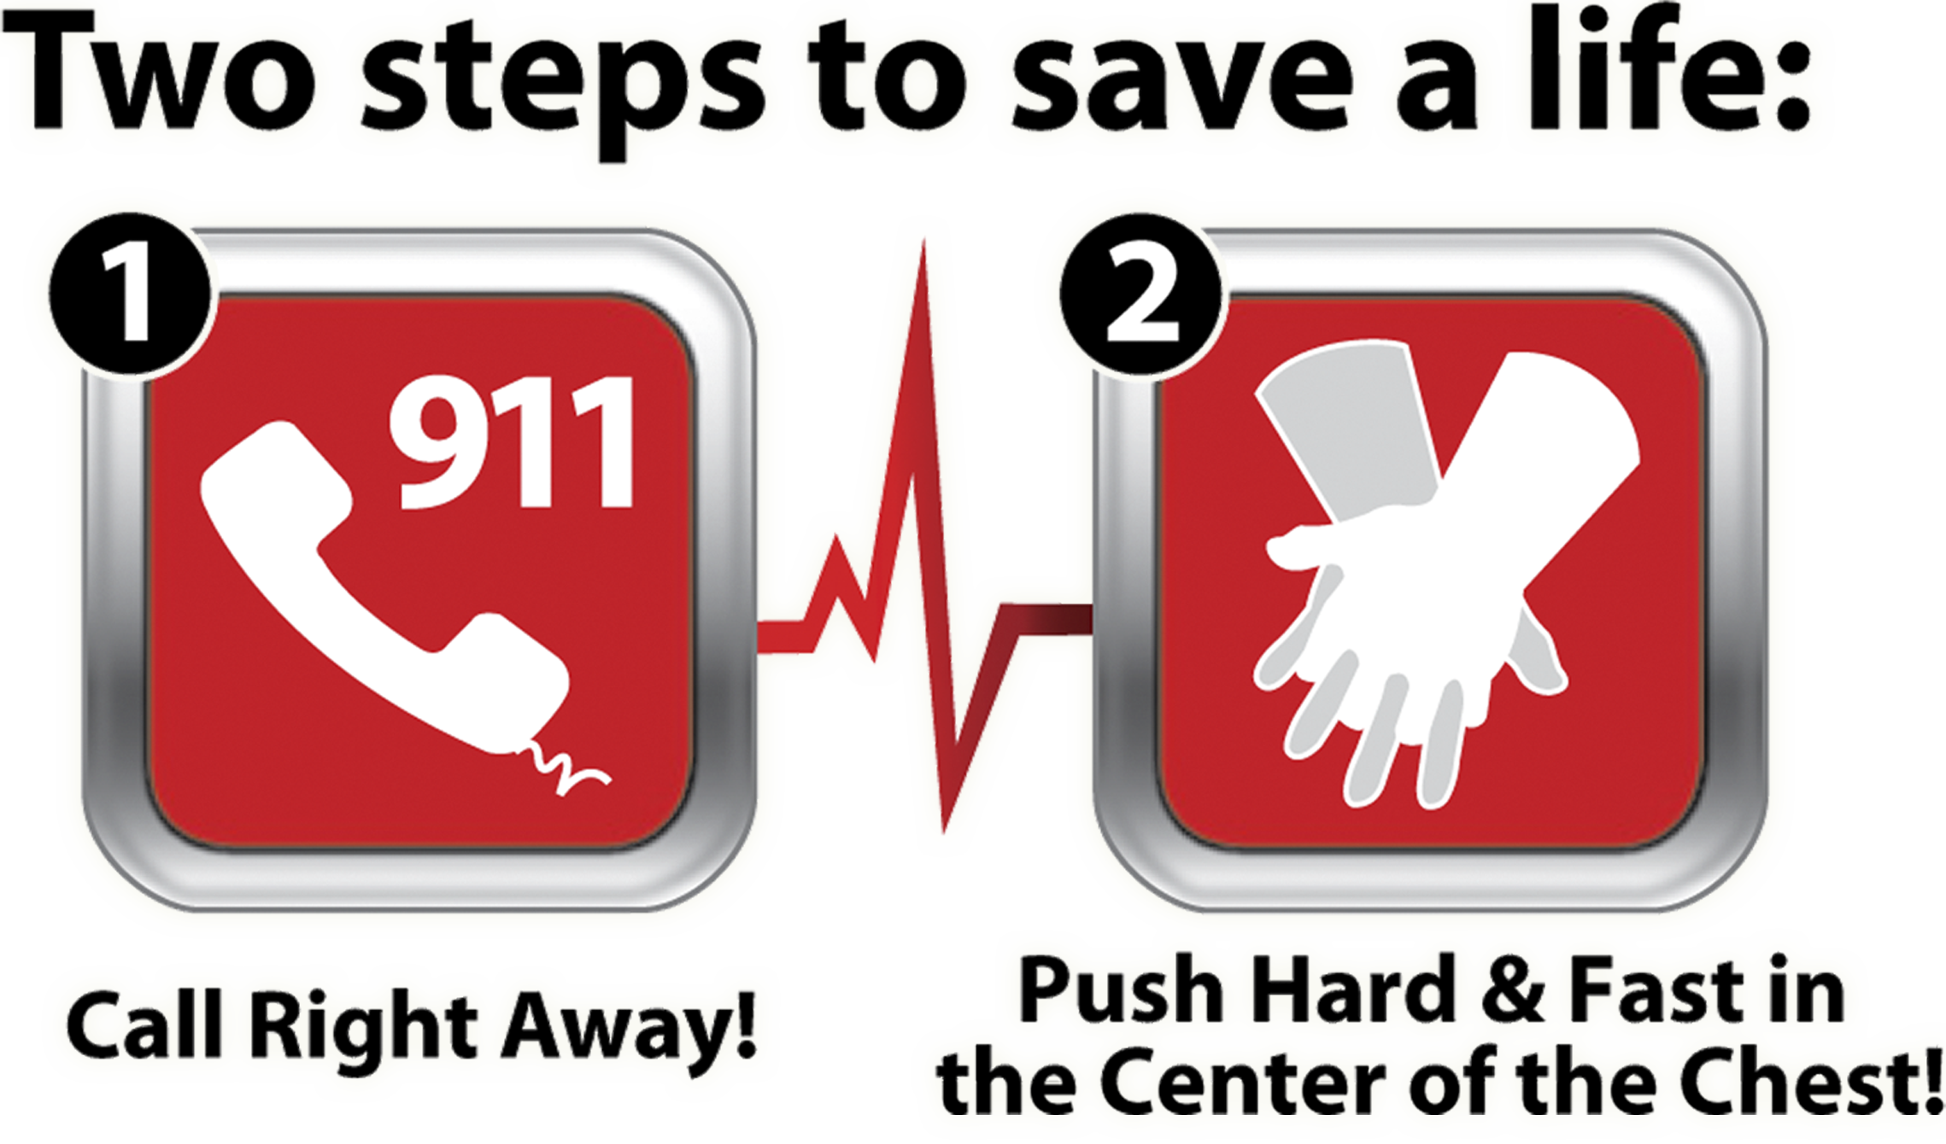

Slide 25
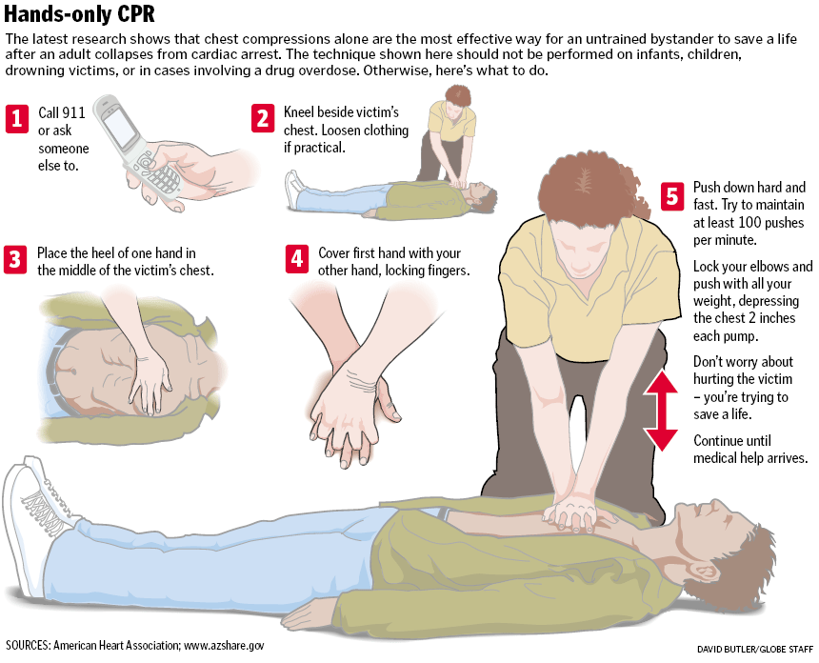

Slide 26
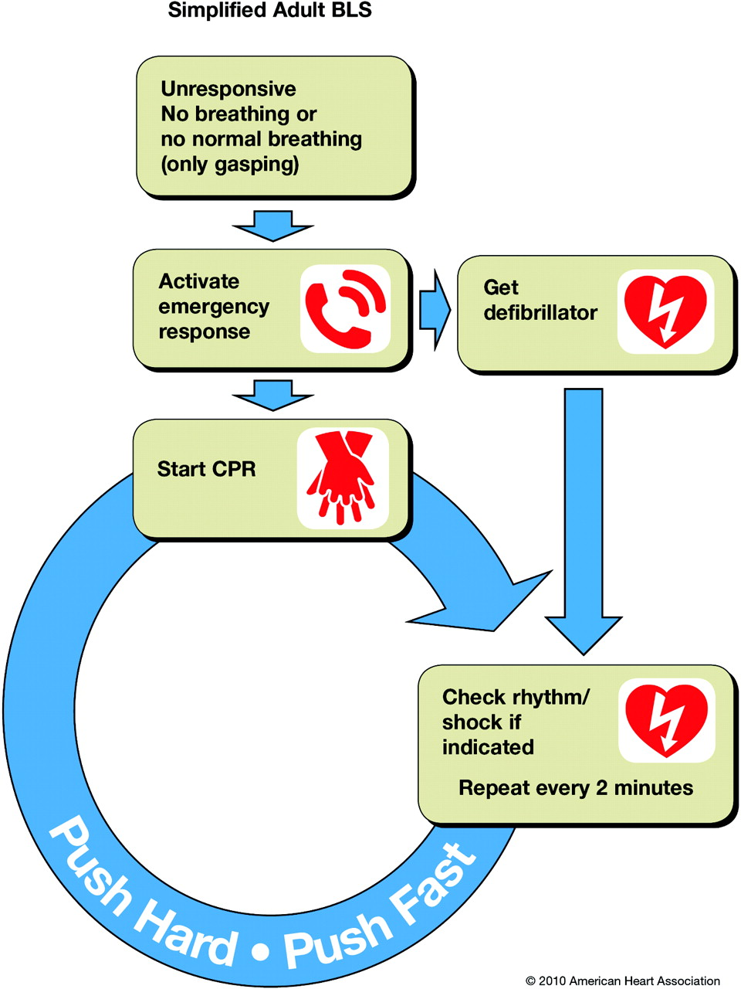
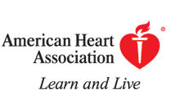
Simplified Adult BLS Algorithm.
Travers A H et al. Circulation 2010;122:S676-S684
Copyright © American Heart Association
Notes:
Simplified Adult BLS Algorithm.

Slide 27
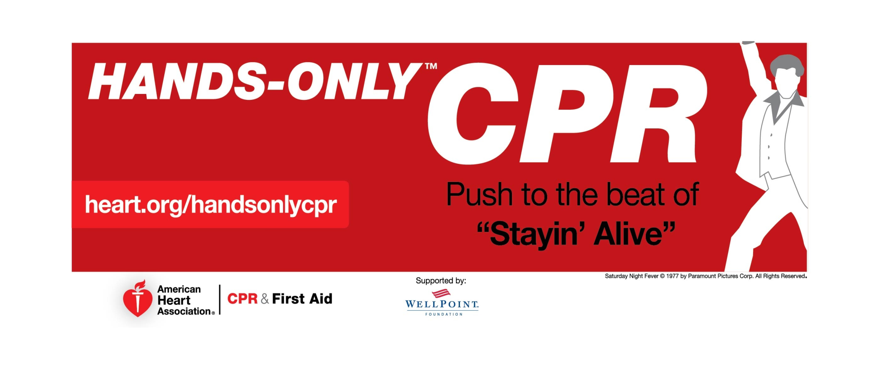
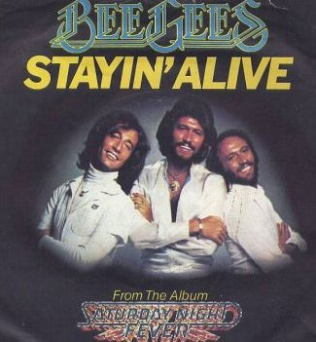
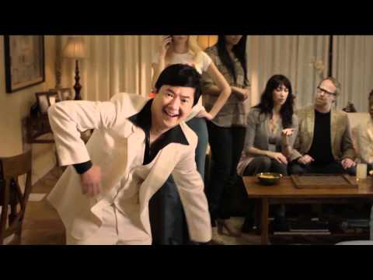

Slide 28
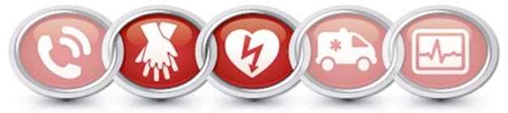
Sudden Cardiac Arrest (SCA) is a leading cause of death in the United States, accounting for an estimated 350,000 deaths each year.
Delivery of CPR is life-saving first aid that can sustain life until advanced care can arrive by helping to maintain vital blood flow to the heart and brain.
Over the past 50 years, 300 million people have been trained in CPR but only about 25% of SCA victims receive bystander CPR.

Slide 29
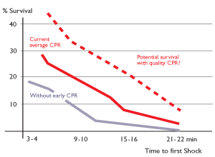
Every minute without CPR following sudden cardiac arrest, the probability of survival reduces by 7-10% per minute.
When bystander CPR is delivered, the patient stands a better chance as the probability for survival reduces to 3-4% per minute.
Overall, bystander CPR increases survival 2-3 times compared to no bystander CPR.

Slide 30
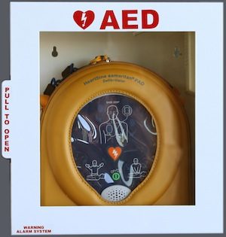
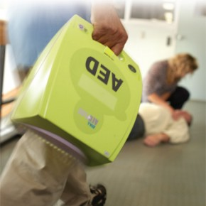
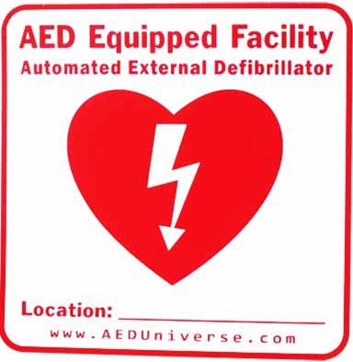
Publicly available AEDs are rarely retrieved and used because bystanders generally cannot see them and have no way to know if one is even available nearby.
Statistics provided by the CARES (Cardiac Arrest Registry to Enhance Survival) Registry indicate that publicly available AEDs are used less than 3% of the time when needed and available. As a result, SCA victims are dying at locations at or near publicly placed AEDs.
AEDs are now widely available in public places such as schools, airports and workplaces.

Slide 31

The PulsePoint app is a pre-arrival notification system designed to support public safety agencies working to improve cardiac arrest survival rates through improved bystander performance.
The purpose of the app is to reduce collapse-to-CPR and collapse-to-defibrillation times by simultaneously dispatching nearby CPR-trained citizens to those in need of CPR, along with detailed public AED location information.

Slide 32
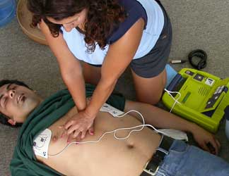
The PulsePoint mobile app alerts CPR-trained bystanders to someone nearby having a sudden cardiac arrest that may require CPR, so that CPR can begin immediately.
The app directs these citizen rescuers, with a live map, to the nearest AED.
The app is automatically activated by the local public safety communications center simultaneous with the dispatch of local fire and EMS resources.

Slide 33

Notifications are made simultaneously with the dispatch of paramedics to anyone within the area that is CPR-trained and has indicated their willingness and ability to assist during an SCA emergency.
These notifications are only made if the victim is in a public place and only to potential rescuers that are in the immediate vicinity of the emergency.
When notifications do occur they intend to target potential citizen rescuers that are primarily within walking distance of the event.

Slide 34
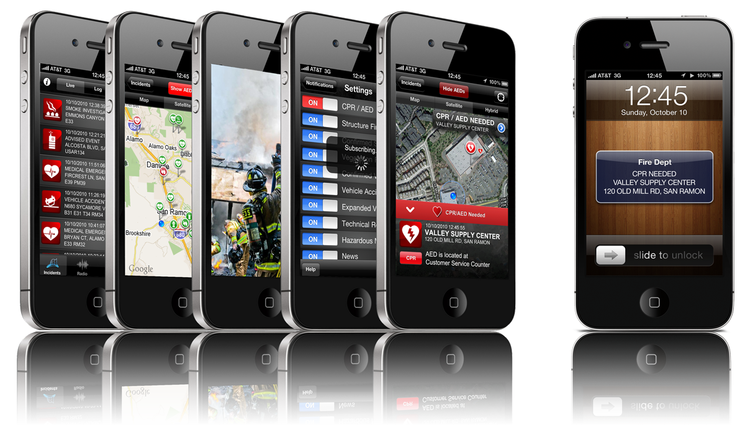

Slide 35
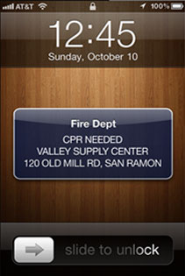
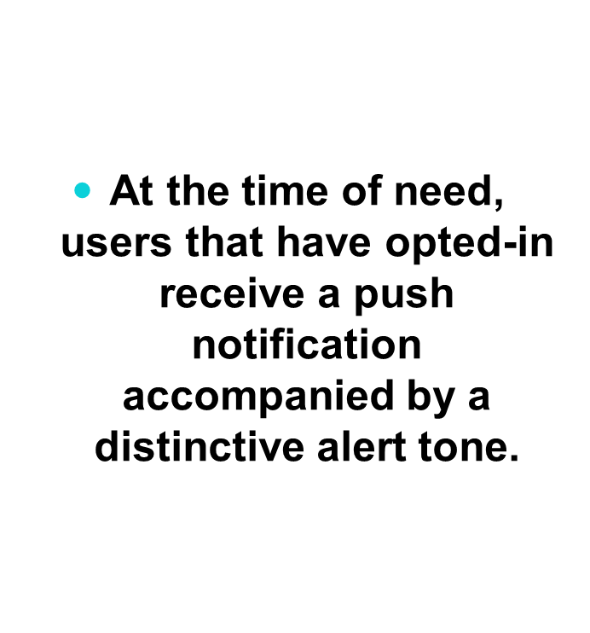

Slide 36
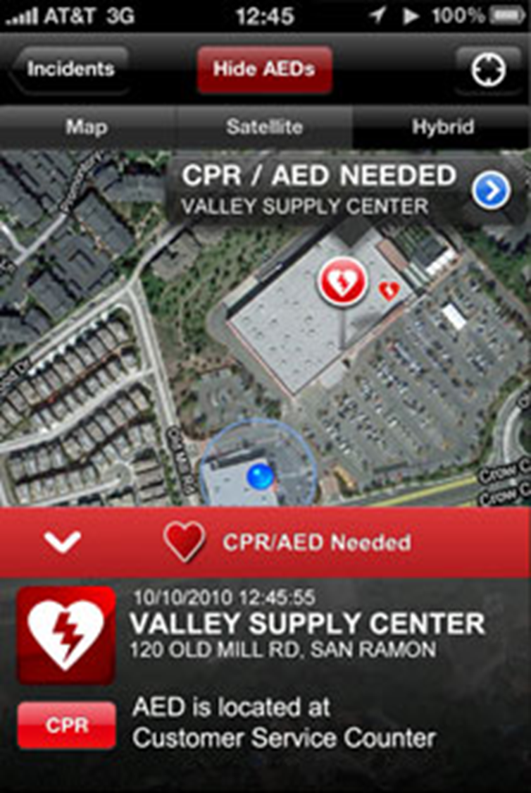
The notification is followed by a map display showing the dispatched location of the emergency along with the precise location of the citizen rescuer – providing for easy navigation between the two.

Slide 37
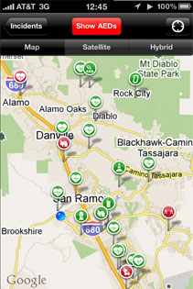
The map display also shows the exact location of the nearest AEDs. In many cases nationwide, nearby AEDs have not been used when they may have made a big difference. The application aims to address this type of failure by informing citizen rescuers where the nearest AED is located – in real-time and in context of their current location

Slide 38
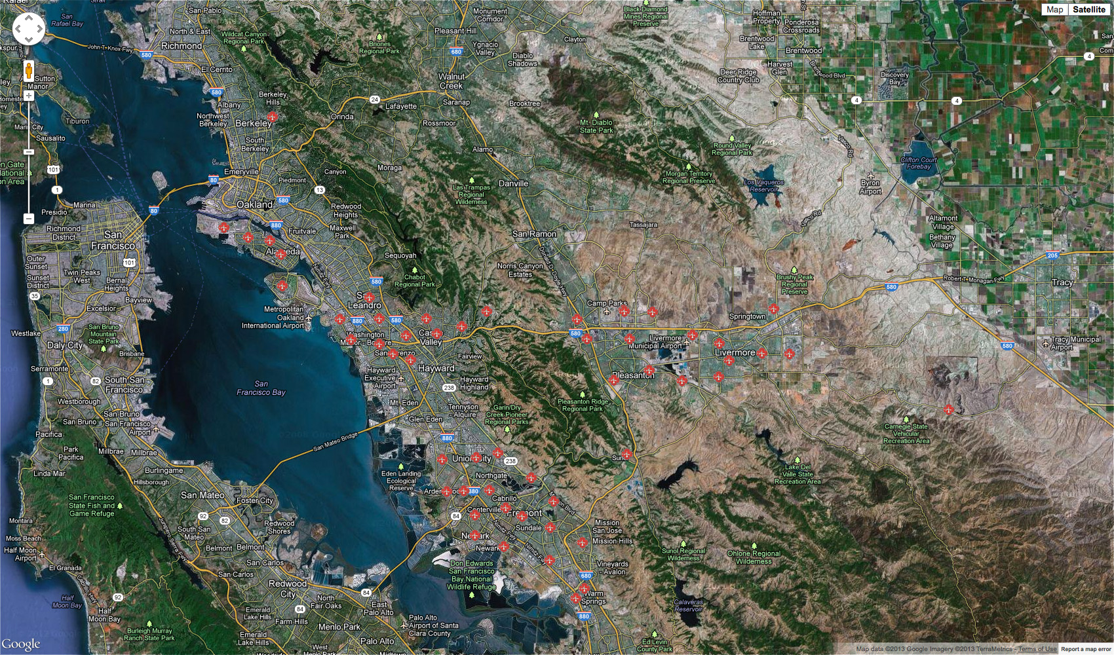
ALAMEDA COUNTY FIRE STATIONS

Slide 39
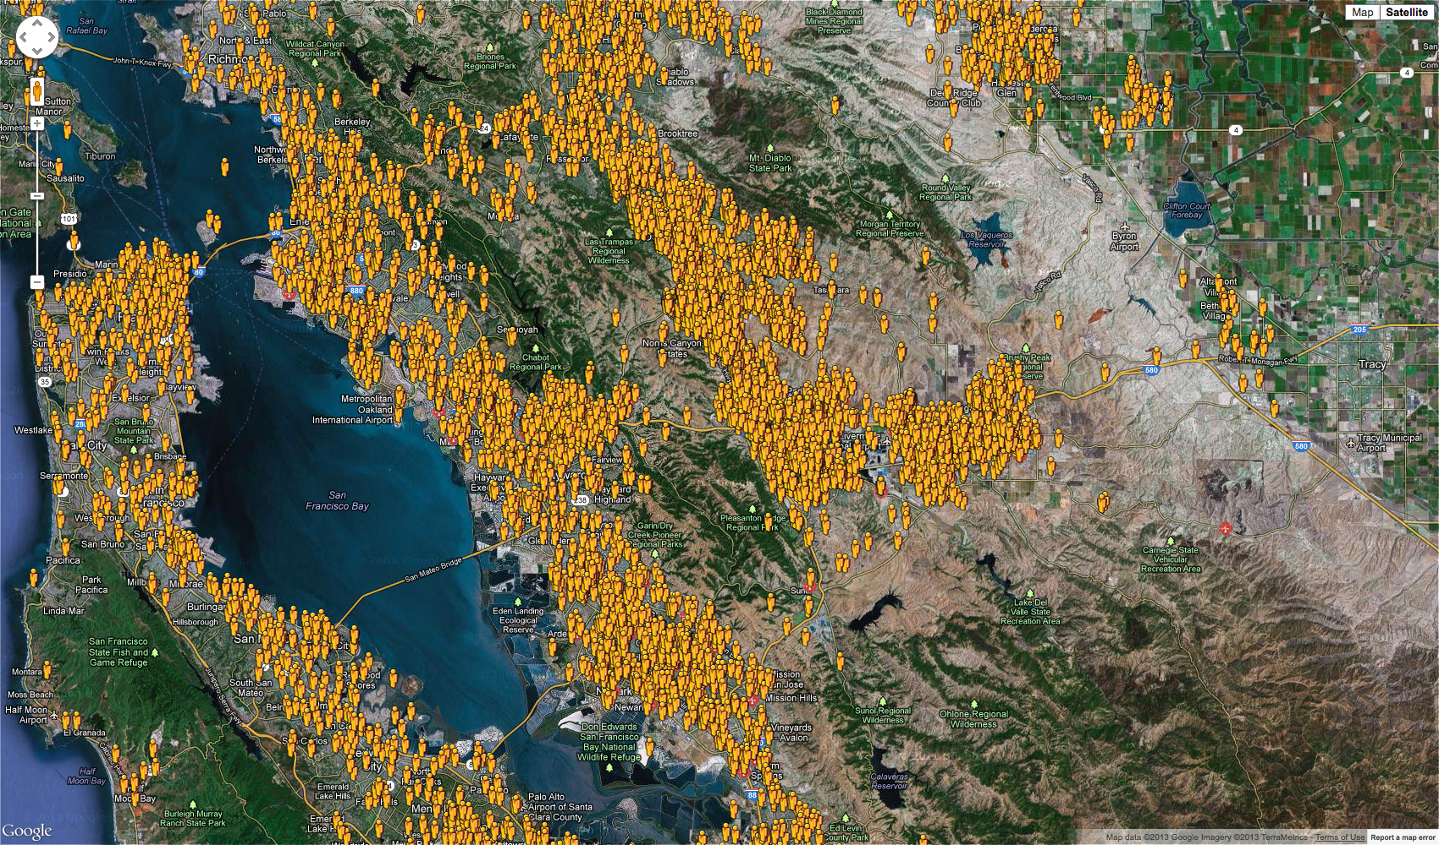
PULSEPOINT RESPONDERS IN ALAMEDA COUNTY

Slide 40
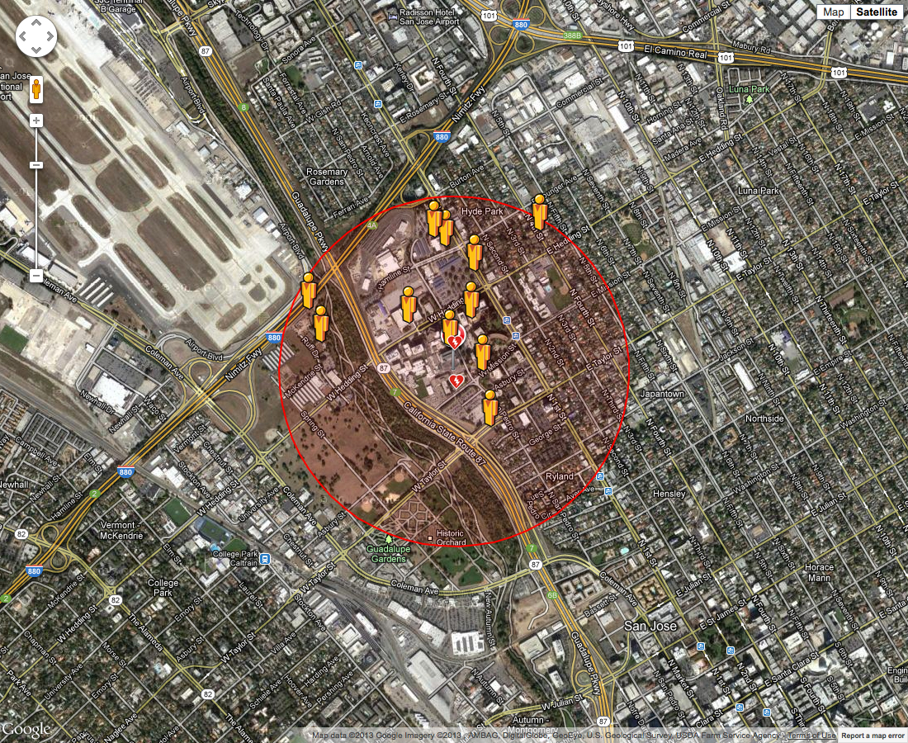
ALAMEDA COUNTY PULSEPOINT ACTIVATION

Slide 41

What are the costs associated?
The app is provided and maintained by the PulsePoint Foundation free of charge to the users.
The supporting services are also provided free of charge to public safety agencies desiring to offer the application in their community.

Slide 42
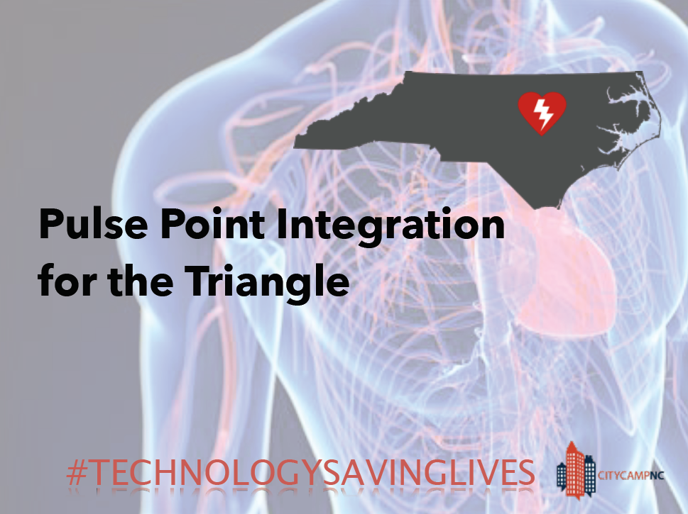
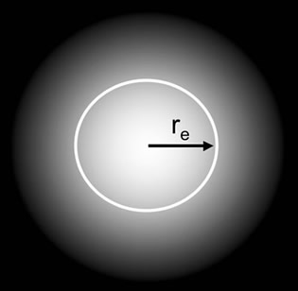
How big is the notification radius?
The app aims to notify those essentially within walking distance of the event location. However, this distance is configurable on an agency by agency basis.
Higher population densities usually warrant a smaller notification radius.
Likewise, a rural area with longer local government response times may choose to notify over a broader area.

Slide 43
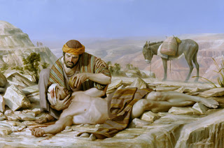
Can I be sued for helping?
The purpose of the Good Samaritan Law is to protect individuals that assist a victim during a medical emergency.
Since the Good Samaritan typically does not have medical training, the law protects him or her from being liable from injury or death caused to the victim during a medical emergency.

Slide 44

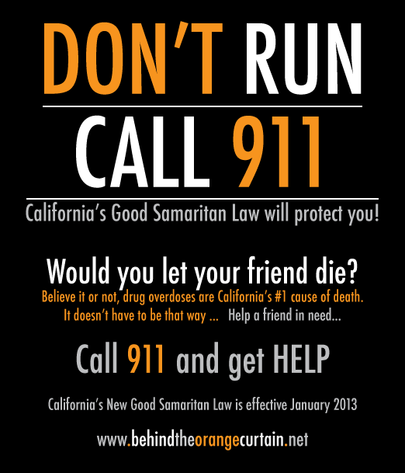
A general layperson is protected under the Good Samaritan laws as long as he or she has good intentions to aid the victim to the best of his or her ability during a medical emergency. A typical example of the wording appears below:
“…a person, who, in good faith, lends emergency care or assistance without compensation at the place of an emergency or accident, and who was acting as a reasonable and prudent person would have acted under the circumstances present at the scene at the time the services were rendered, shall not be liable for any civil damages for acts or omissions performed in good faith.”

Slide 45
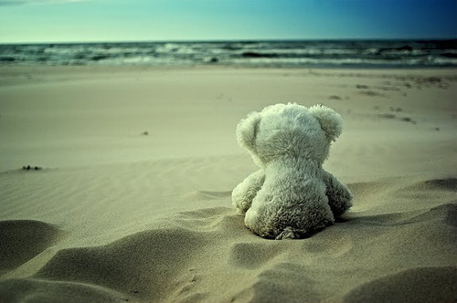
What if too many people show up?
Only about one quarter of Sudden Cardiac Arrest victims receive bystander CPR, and public access Automated External Defibrillators (AEDs) are used less than 3% of the time when needed and available.
The current situation is far too few bystander rescuers – not too many. The goal of the app is to engage additional bystanders in these lifesaving acts.

Slide 46
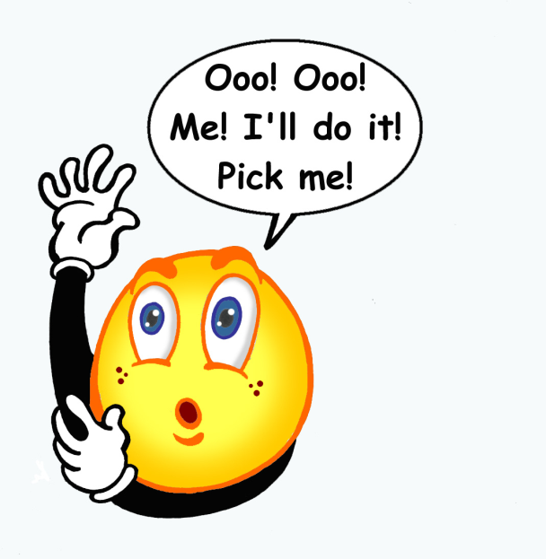
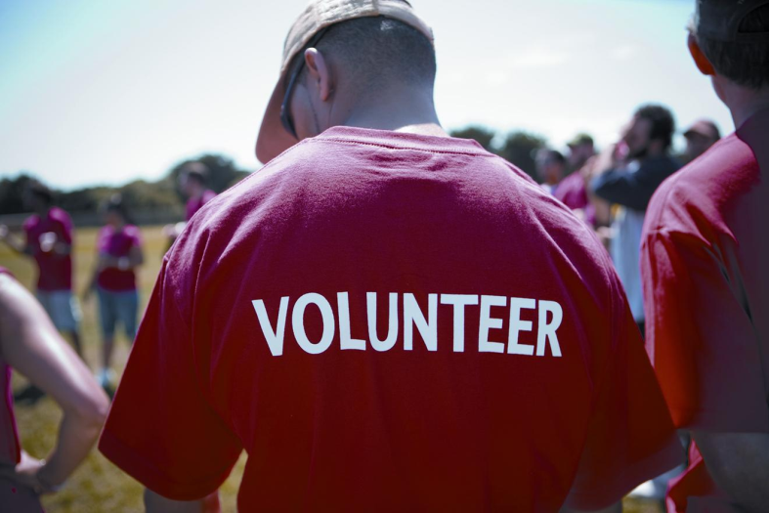
How do you know if subscribers are really trained in CPR?
CPR today is very easy to perform and can be learned quickly in informal settings such as community street fairs, group training sessions, take-home DVD-based courses, or even by watching brief online videos.
Therefore, there is no ability or even reason to verify that someone volunteering to help others with CPR has been formally trained.

Slide 47
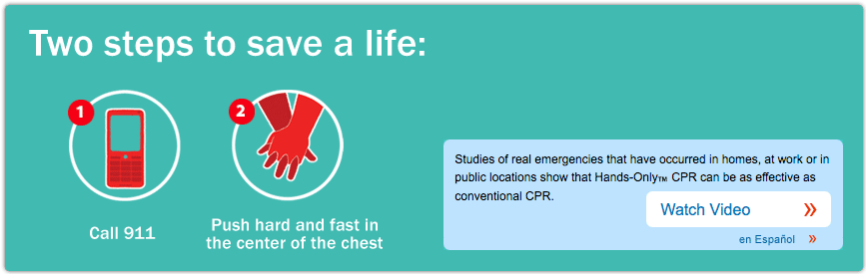
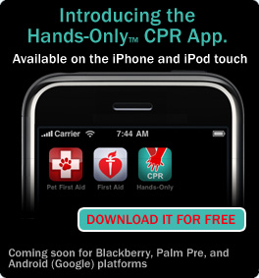

Slide 48
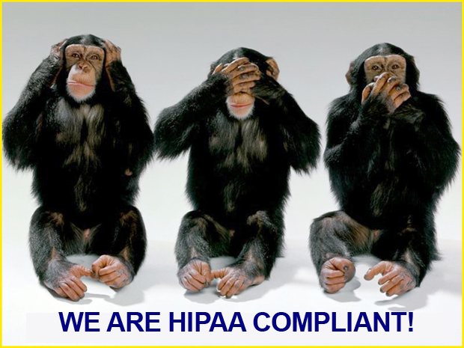
WHAT ABOUT HIPAA OR OTHER PRIVACY CONCERNS?
The Health Insurance Portability and Accountability Act (HIPAA) protects the privacy of individually identifiable health information.
On a ‘CPR Needed’ notification, the app reports only an address (in a public place) and a business name, if available. Individually identifiable health information, such as name, birth date, or Social Security Number are not reported or known to the PulsePoint application.

Slide 49
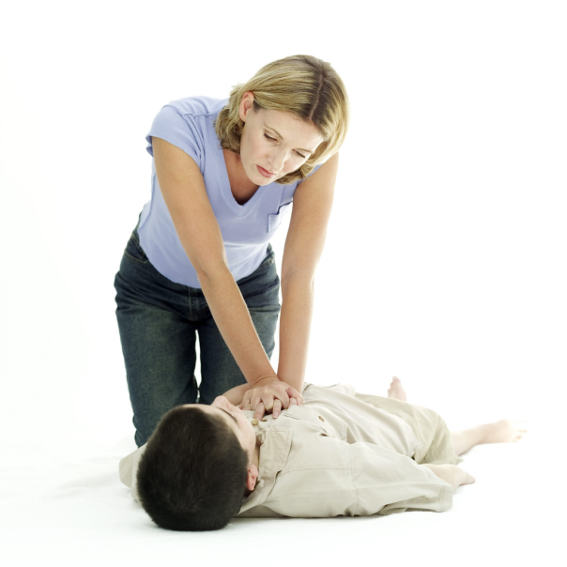
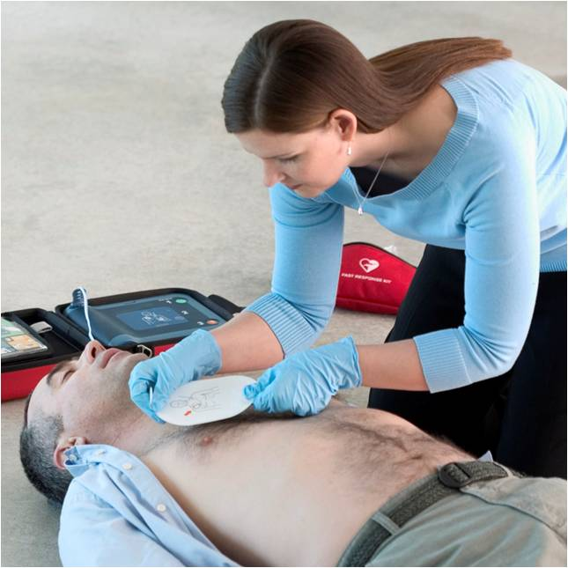
How can PulsePoint make a difference?
Improve the frequency of bystander CPR by increasing awareness of cardiac events beyond the traditional “witnessed” area.
Improve awareness and speed of public access defibrillator (AED) deployment by providing precise location information of nearby devices in real-time and in context with the rescuers location.

Slide 50


Potential Community Benefits
  Better survival from SCA
  Positive message for community
  Better utilization of EMS resources
  National attention to Columbus
  Participation in cutting-edge research
  “Best place in the country to have SCA”

Slide 51

CFD Experience with Pulsepoint
3203 subscribers
85 CPR alerts
CPR alert at Ohio State Fair with 6 notifications

Slide 52
STORIES OF SUCCESS

Slide 54
Where can I learn more about PulsePoint?
The app is available for download from the Apple App Store and the Android/Google Play Marketplace.
Visit the foundation website at www.PulsePoint.org
Follow @PulsePoint for general news and information.
Follow @1000livesaday for real-time app activations.
Watch the Public Service Announcement at http://vimeo.com/34174631

Slide 55

QUESTIONS?????????????
dkeseg@columbus.gov

